Slide 1
Composite Signals
A single a frequency sine wave is not useful in data communications;
We need to send a composite signal to communicate data.
A composite signal is made of many simple sine waves.
.

Slide 2
Composite Signals
In the early 1900s, the French mathematician Jean-Baptiste Fourier showed that any composite signal is actually a combination of simple sine waves with different frequencies, amplitudes, and phases.
.

Slide 3
Composite Signals
A composite signal can be periodic or nonperiodic.
A periodic composite signal can be decomposed into a series of simple sine waves with discrete frequencies that have integer values (1, 2, 3, and so on).
A nonperiodic composite signal can be decomposed into a combination of an infinite number of simple sine waves with continuous frequencies, frequencies that have real values.
.

Slide 4
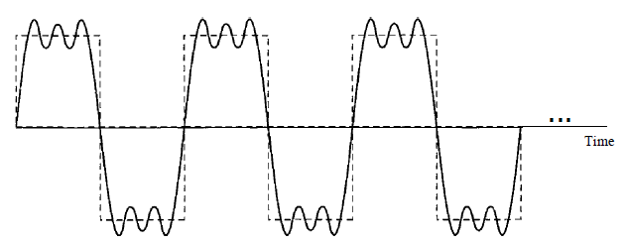
Composite Signals
Figure shows a periodic composite signal with frequency f.
This type of signal is not typical of those found in data communications.
A composite periodic signal
.

Slide 5
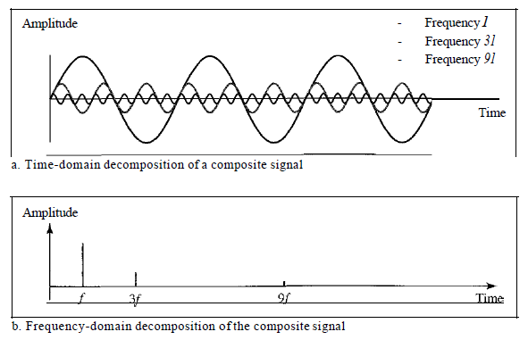
Composite Signals
It is difficult to manually decompose signal into a series of simple sine waves.
There are tools, both hardware and software, that can help us do the job.
Decomposition of a composite periodic signal in the time and frequency domains
.

Slide 6
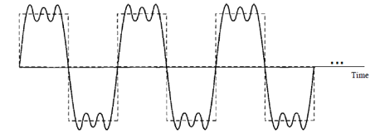
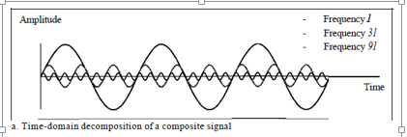
Composite Signals
The amplitude of the sine wave with frequency f is almost the same as the peak amplitude of the composite signal.
The amplitude of the sine wave with frequency 3f is one-third of that of the first, and the amplitude of the sine wave with frequency 9f is one-ninth of the first.
.

Slide 7
Composite Signals
The frequency of the sine wave with frequency f is the same as the frequency of the composite signal; it is called the fundamental frequency, or first harmonic.
The sine wave with frequency 3f has a frequency of 3 times the fundamental frequency; it is called the third harmonic.
The third sine wave with frequency 9fhas a frequency of 9 times the fundamental frequency; it is called the ninth harmonic.
.

Slide 8

Periodic analog signal
Mathematically, a signal s(t) is defined to be periodic if and only if
where T is the period of the signal.
.

Slide 9

the frequency components of the square wave with amplitudes A and –A can be expressed as follows:

Slide 10
Periodic analog signal
Periodic analog signal characterized by 3 parameters.
Representation of sine wave
s (t) = A sin (2πft + φ)
Where A is peak amplitude, f is frequency and φ is the phase.
.

Slide 11
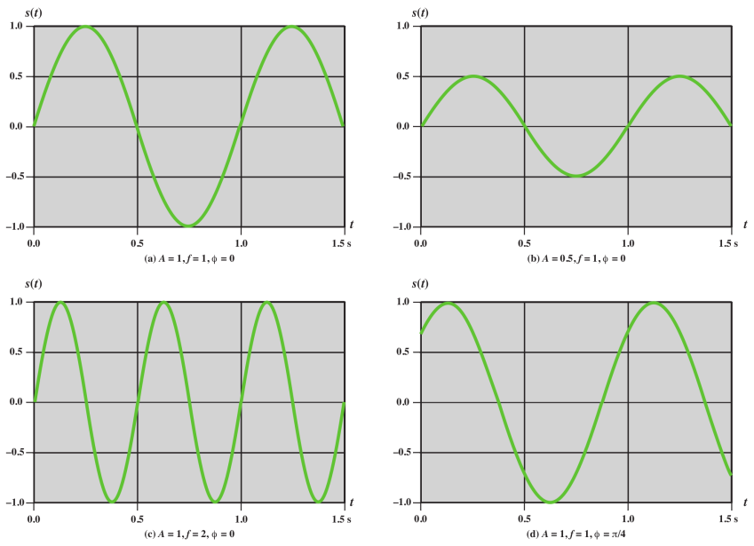
.

Slide 12
UNITS of Parameter
Amplitude : volts, milli (10⁻³) volt, KV(10³)
Frequency : Hz, KHz(10³), MHz(10⁶), GHz(10⁹), THz(10¹²)
Time : second, milli second(10⁻³), micro second(10⁻⁶), ns(10⁻⁹), ps(10⁻¹²)
Phase : degree , radian
.

Slide 13
Composite signals can be expressed as a combination of simple sine waves with different amplitude, frequency and phase.
s (t ) = A₁ sin (2πf₁t + φ₁) + A₂ sin (2πf₂t + φ₂) + A₃ sin (2πf₃t + φ₃) +……..
.

Slide 14
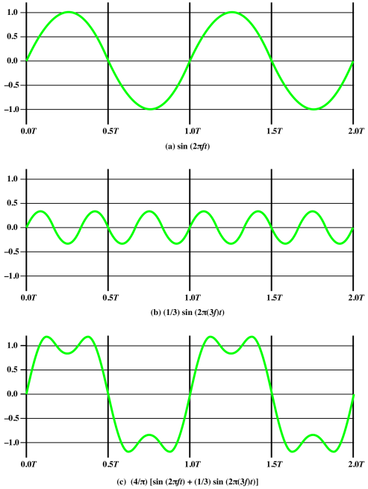
s (t ) = A₁ sin (2πf₁t + φ₁) + A₂ sin (2πf₂t + φ₂) +……..
.

Slide 15
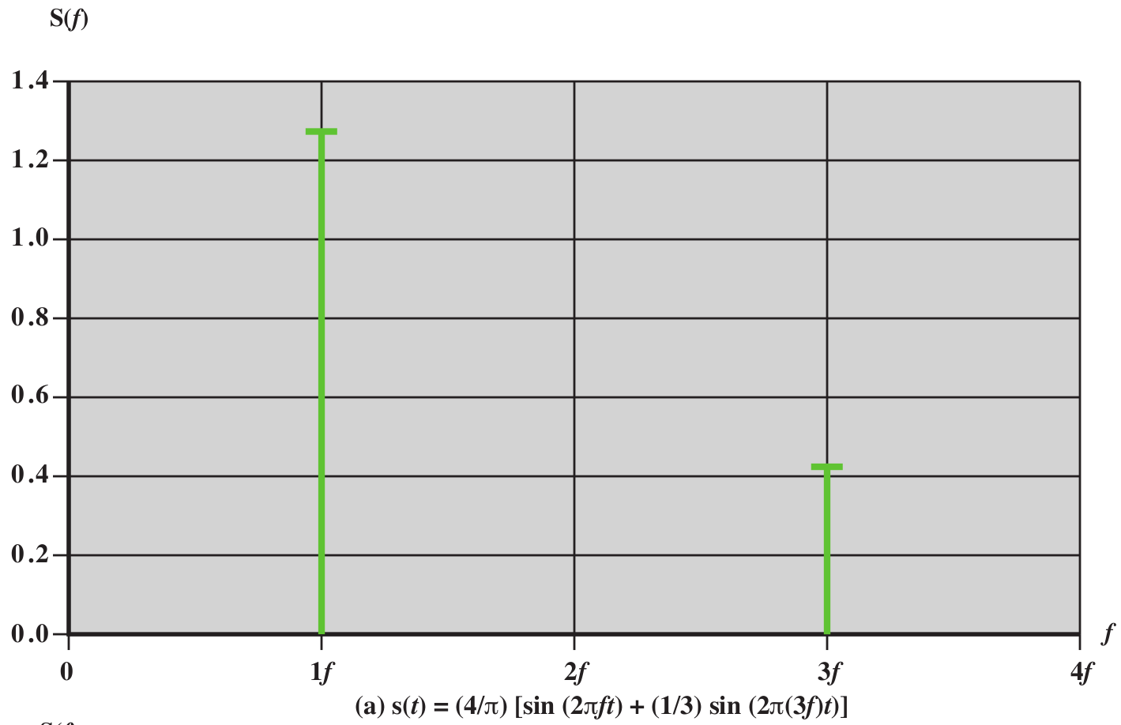
.

Slide 16
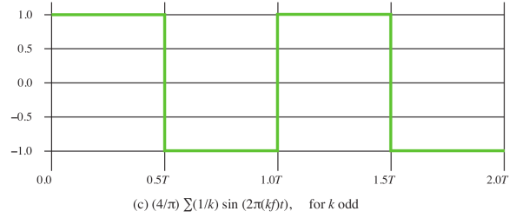
Digital signal
Based on Fourier analysis, a digital signal is a composite analog signal.
A digital signal can be considered as a signal with an infinite number of frequencies.
.

Slide 17

DIGITAL SIGNALS
Digital Signal as a Composite Analog Signal
Fourier analysis can be used to decompose a digital signal.
If the digital signal is periodic, (rare in data communications ), the decomposed signal has a frequency domain representation with an infinite bandwidth and discrete frequencies.
If the digital signal is nonperiodic, the decomposed signal still has an infinite bandwidth, but the frequencies are continuous.
.

Slide 18
Digital signal
Most digital signals are nonperiodic
period and frequency are not appropriate characteristics.
Bit interval
Time required to send a single bit.
.

Slide 19
Digital signal
Bit Rate
Number of bits sent in 1 second, expressed in bits per second (bps).
Number of bit intervals per second.
.

Slide 20

Digital signal
A digital signal can have more than two levels.
In this case, we can send more than 1 bit for each level.
.

Slide 21
DIGITAL SIGNALS
We send 1 bit per level in part a and 2 bits per level in part b of the figure.
In general, if a signal has L levels, each level needs log ₂L bits.
.

Slide 22
DIGITAL SIGNALS
A digital signal has eight levels. How many bits are needed per level?
Number of bits per level =log₂ 8 =3
Each signal level is represented by 3 bits.
.

Slide 23
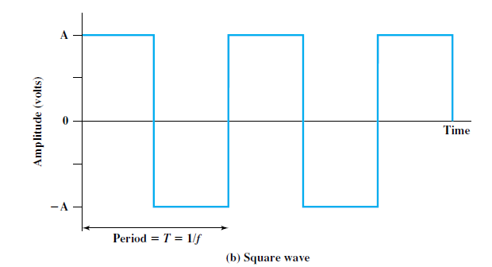
Relationship between Data Rate and Bandwidth
consider the square wave.
let positive pulse represent binary 0 negative pulse represent binary 1.
Then the waveform represents the binary stream 0101. . . .
The duration of each pulse is T/2 = 1/(2f )
thus the data rate is 2f bits per second (bps).
.

Slide 24
Relationship between Data Rate and Bandwidth
Waveform has an infinite number of frequency components and hence an infinite bandwidth.
What happens if we limit the bandwidth to just the first three frequency components?
Suppose a digital transmission system is capable of transmitting signals with a bandwidth of 4 MHz.
What data rate can be achieved? We look at 3 cases.
.

Slide 25
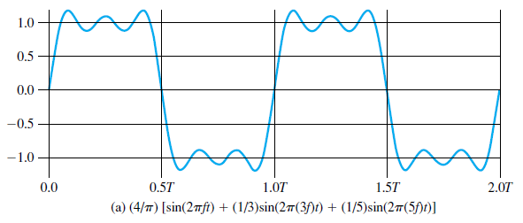
Relationship between Data Rate and Bandwidth
Case I.
5f – f = 4MHz
f = 1 MHz
T = 1/f = 1/1MHz =
f 5f
In we can second 2bits
bandwidth
So in 1 second we can send 2Mbps
.

Slide 26
Relationship between Data Rate and Bandwidth
Case 2
5f – f = 8MHz
f = 2 MHz
T = 1/f = 1/2MHz =
f 5f
In we can second 2bits
bandwidth
So in 1 second we can send 4Mbps
.

Slide 27
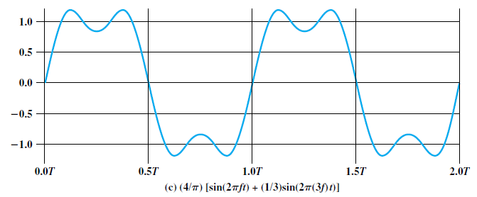
Relationship between Data Rate and Bandwidth
Case 3
3f – f = 4MHz
f = 2 MHz
T = 1/f = 1/2MHz =
f 3f
In we can second 2bits
bandwidth
So in 1 second we can send 4Mbps
.

